Slide 1
MsPhamEnglish
UNIT 13 – LESSON 3

Slide 2
VOCABULARY

Slide 3
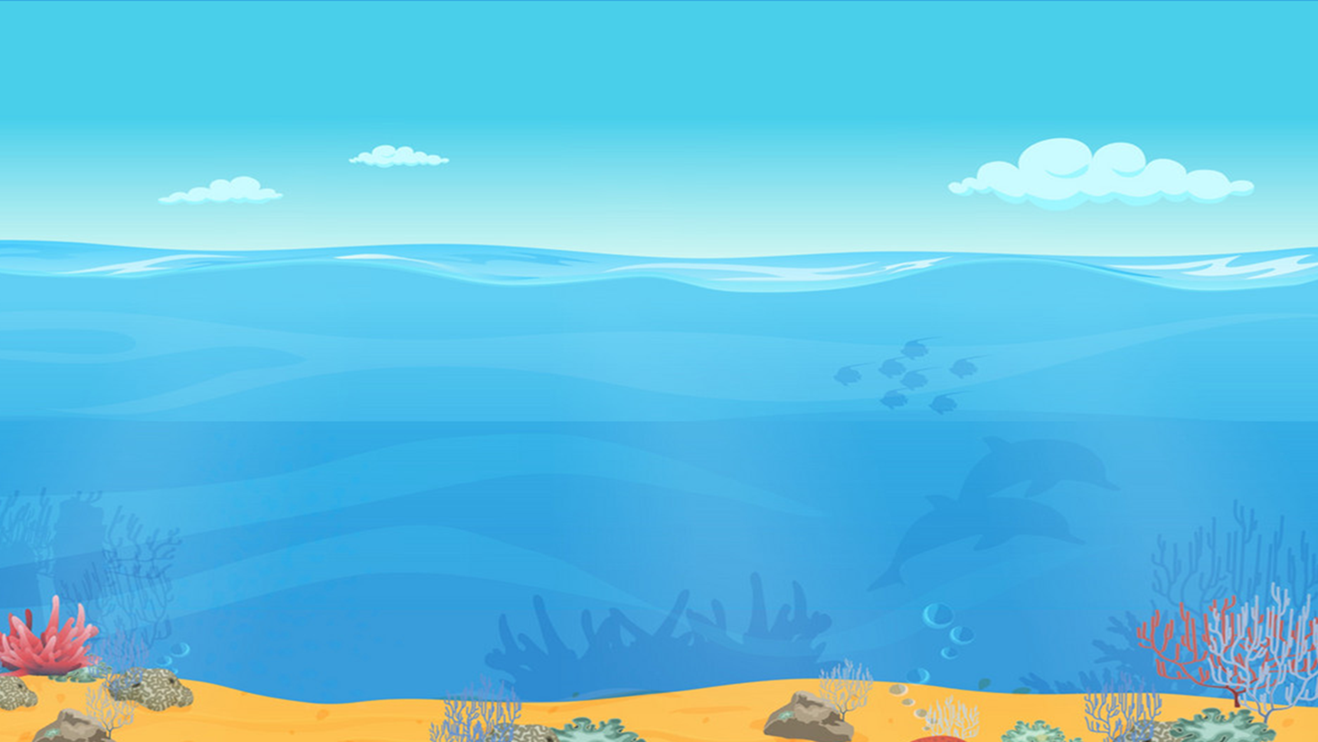
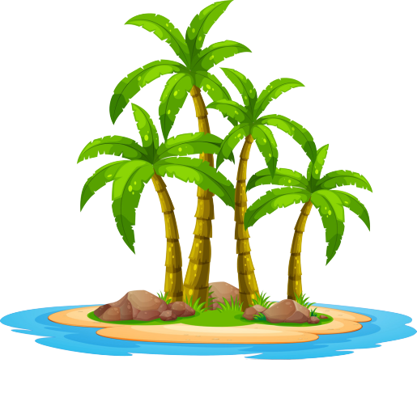
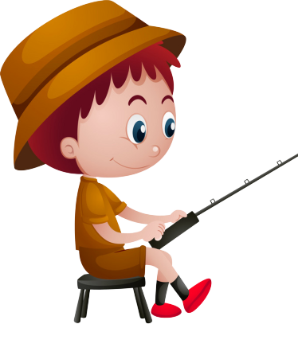
GO FISHING
Game
PLAY
EXIT

Slide 4
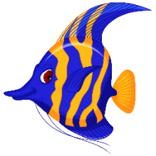
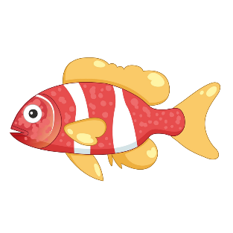
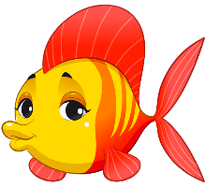
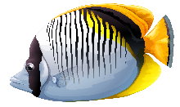
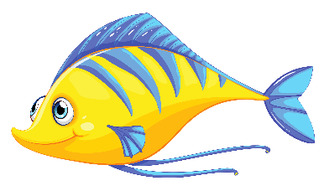
0
Score:
EXIT
8
13
6
12
1
2
7
11
14
5
3
9
4
10
15

Slide 5
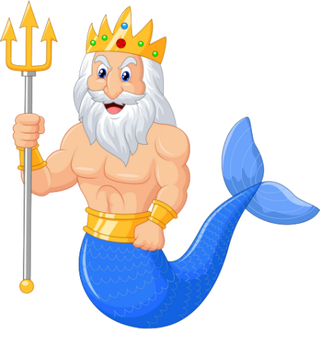
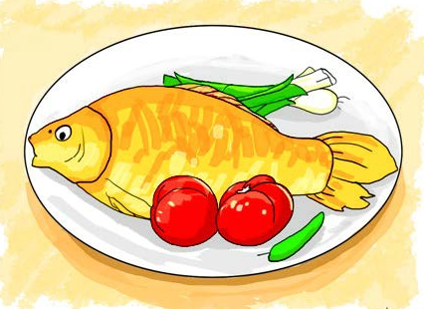
A
FISH
Her favourite food is ____.
B
BEEF
C
PORK
D
VEGETABLES

Slide 6
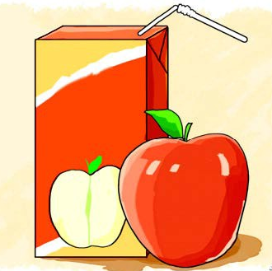
A
It's orange juice.
A: What's your favourite drink?
B: _________.
B
It's apple juice.
C
Yes, please.
D
No, thank you.

Slide 7
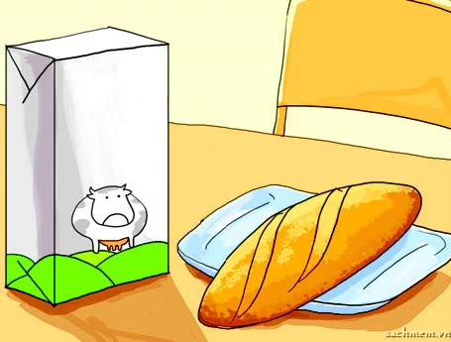
A
bread and milk
I'd like some _______.
B
bread and water
C
rice and lemonade
D
bread and juice

Slide 8
A
No, thanks. I'd like some milk.
What's your favourite food?
B
It's chicken.
C
It's orange juice.
D
Yes, please. I love noodles.

Slide 9
A
It's orange juice.
What's your favourite drink?
B
No, thanks.
C
It's fish.
D
Yes, please.

Slide 10
A
It's vegetable.
Would you like some milk?
B
No, thanks. I'd like
some bread.
C
It's orange juice.
D
Yes, please. I love milk.

Slide 11
A
What's your
favourite drink?
____________?
It's chicken.
B
What's your
favourite food?
C
Would you like
some milk?
D
Would you like
some vegetable?

Slide 12
A
What's your
favourite drink?
_____________?
No, thanks. I'd like some milk.
B
Would you like
some chicken?
C
Would you like
some water?
D
What's your
favourite food?

Slide 13
A
Would you like
some lemonade
___________?
Yes, please. I love lemonade.
B
What's your
favourite food?
C
What's your
favourite drink?
D
Would you like
some water?

Slide 14
A
Do
Mai: __________ you like some beef?
Linda: Yes, please. I love beef.
B
Would
C
Are
D
What

Slide 15
A
Would
__________ is your favourite food?
B
where
C
what
D
When

Slide 16
A
the
What's _____ favourite food?
B
my
C
you
D
your

Slide 17
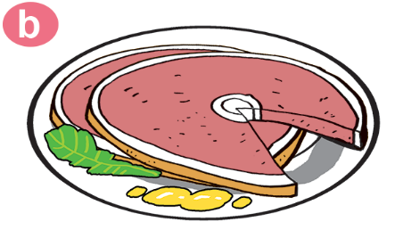
A
beef
Would you like some_____?
Yes,please
B
rice
C
pork
D
bread

Slide 18
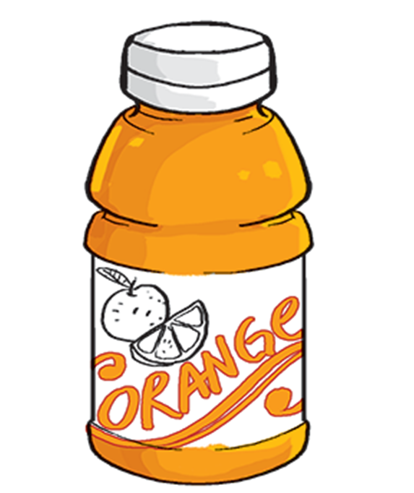
A
It’s lemonade.
What's your favourite drink?
B
It’s water.
C
It’s orange.
D
It’s orange juice.

Slide 19
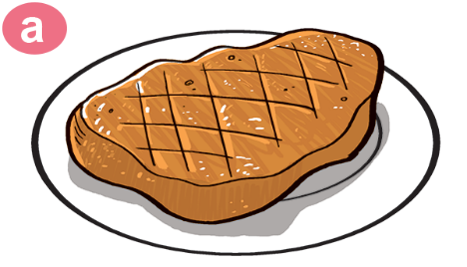
A
I love water.
What's your favourite food?
B
No, I love beef.
C
Yes, I love beef.
D
It’s beef.

Slide 20
PHONICS

Slide 21
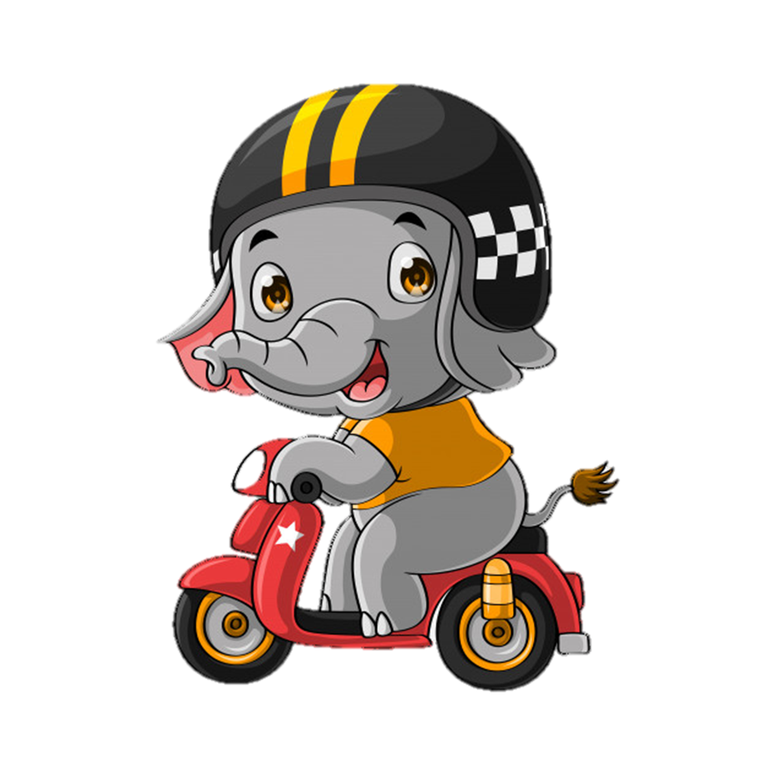
1. Listen and repeat
f | beef | My favourite food is beef.
 | leaf | The leaf is yellow.
sh | fish | Would you like some fish?
 | dish | That's a big dish of fish.

Slide 22
2. Listen and circle. Then write and say aloud.
1. My favourite food is ______.
a. fish b. beef
2. Would you like some ______?
a. fish b. beef
3. What colour is this ______, Mummy?
a. leaf b. dish
4. She likes this ______ very much.
a. leaf b. dish
2
3
4

Slide 23
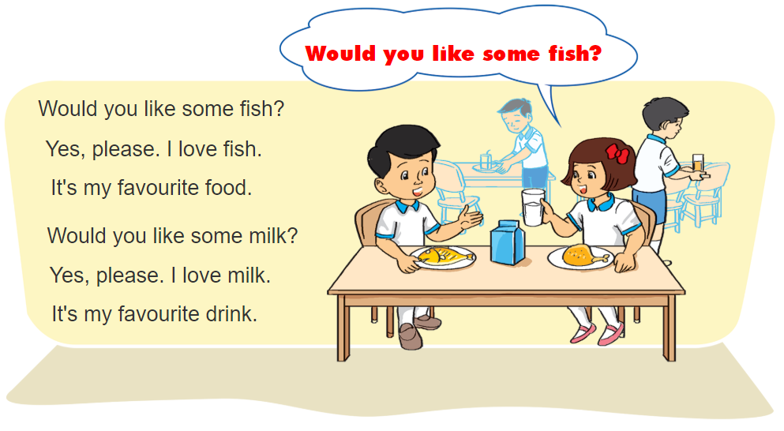
3. Let’s chant

Slide 24
4. Read and complete.
Hi. My name is Linda. I like beef. It is my favourite food. My favourite drink is orange juice. I don't like vegetables. My younger brother Peter doesn't like beef. He loves chicken. It is his favourite food. He loves lemonade too. Lemonade is his favourite drink. He drinks it every day.
Person | Favorite food | Favorite drink
Linda
Peter
beef
orange juice
chicken
lemonade

Slide 25
5. Write about your favourite food and drink
My name is ________________.
I love ________________. It's ________________ food.
I like ________________. It's ________________ drink.

Slide 26
6. Project
Interview your classmates about their favourite food and drink.
Then report the results to the class.
Name | Favourite food | Favorite drink
1. Thu Huong | chicken | milk
2.
3.
4.

