Slide 1
LOOK BACK BEFORE LOOKING FORWARD
1
T | E | A | C | H | E | R
2
W | O | R | K | E | R
3
N | U | R | S | E
4
S | T | U | D | E | N | T
5
F | A | R | M | E | R
HOUSE

Slide 2
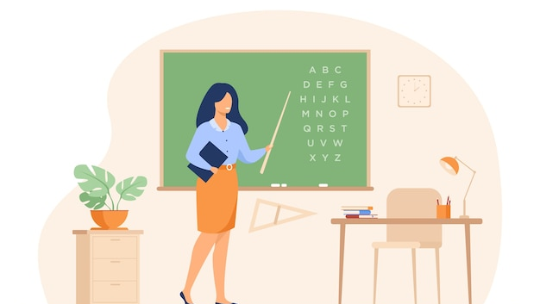
What’s her job?

Slide 3
What’s his job?

Slide 4
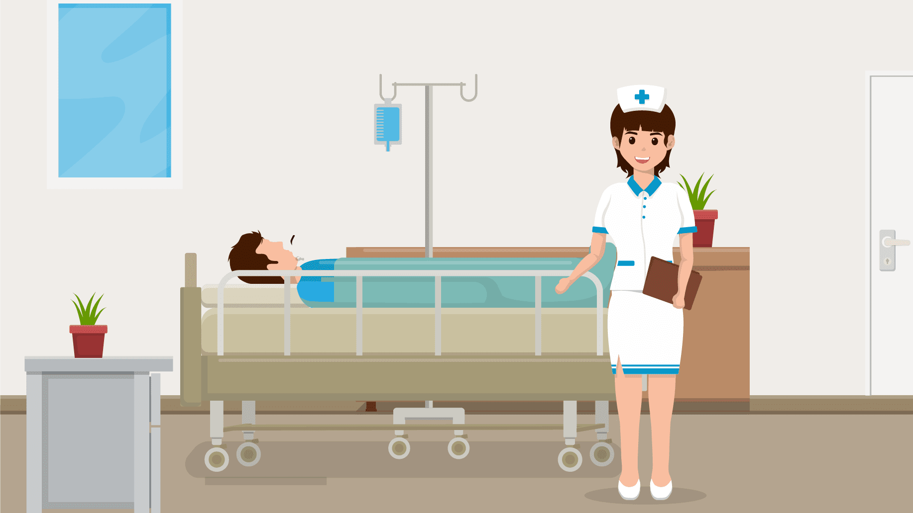
What’s her job?

Slide 5
What’s her job?

Slide 6
What’s his job?

Slide 7
13
MY HOUSE
LESSON 1 PERIOD 1
(P.18)

Slide 8
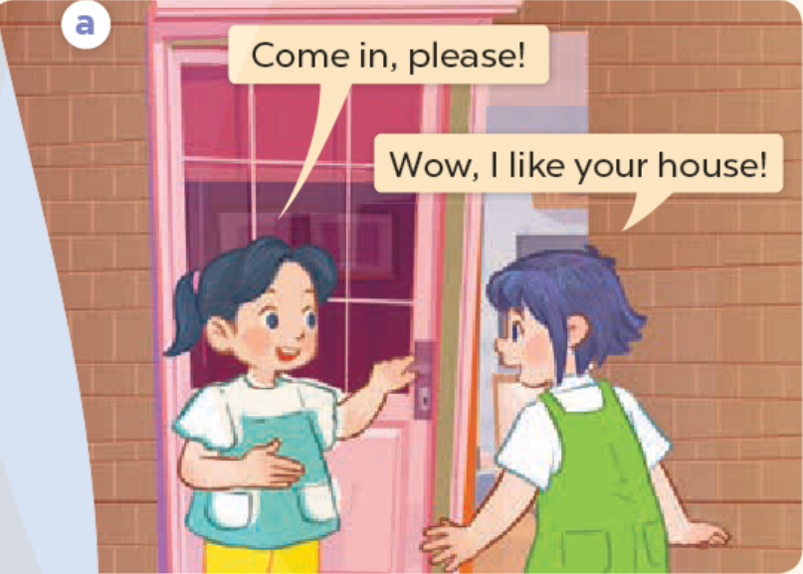
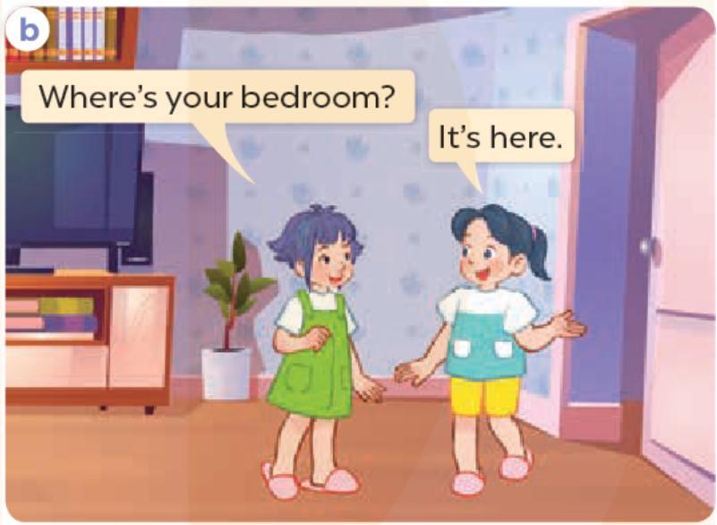
ACTIVITY 1: LOOK, LISTEN AND REPEAT
WHAT ARE THEY DOING?
WHO ARE THEY?
Notes:
Mai and Linh – 16s

Slide 9
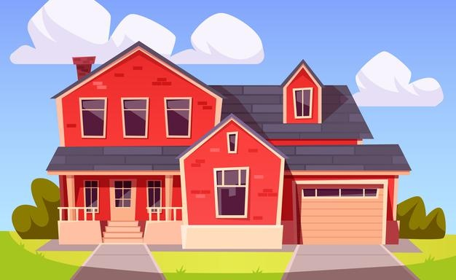
House
/haʊs/
Notes:
https://www.freepik.com/free-vector/suburban-house-residential-building-from-red-brick-with-garage_13778450.htm?query=house

Slide 10
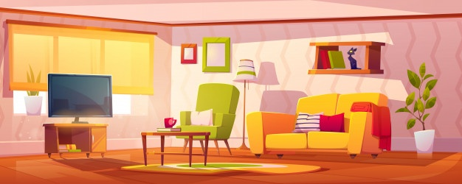
Living room
/ˈlɪv.ɪŋ ˌruːm/
Notes:
https://www.freepik.com/free-vector/spring-interior-living-room_7222484.htm

Slide 11
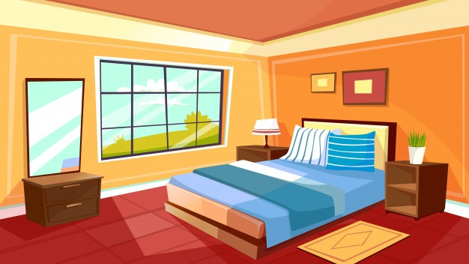
Bedroom
/ˈbed.ruːm/
Notes:
https://www.freepik.com/free-vector/cartoon-bedroom-interior-background-template-cozy-modern-house-room-morning-light_2238484.htm#query=bedroom&position=5&from_view=search

Slide 12
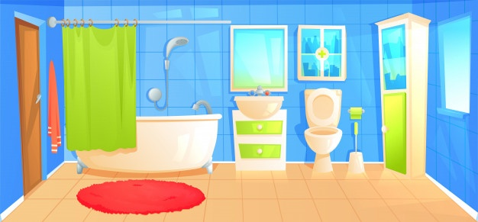
Bathroom
/ˈbæθ.ruːm/
Notes:
https://www.freepik.com/free-vector/bathroom-design-interior-room-with-ceramic-furniture-background-template_4015745.htm#query=bathroom&position=13&from_view=search

Slide 13
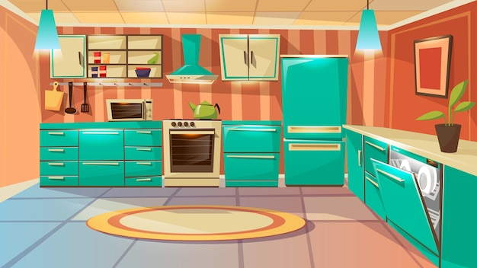
Kitchen
/ˈkɪtʃ.ən/
Notes:
https://www.freepik.com/free-vector/bathroom-design-interior-room-with-ceramic-furniture-background-template_4015745.htm#query=bathroom&position=13&from_view=search

Slide 14
What’s this?
2
3
Living room
1
Kitchen
5
4
House
Bathroom
Bedroom

Slide 15
This is my house.
That is my house.
Here!
There!

Slide 16
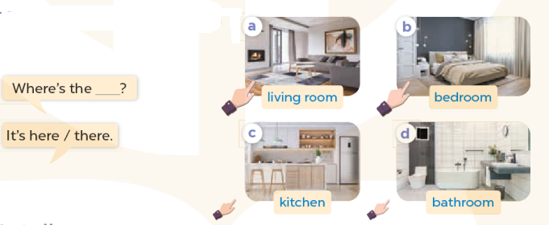
ACTIVITY 1: LOOK, LISTEN AND REPEAT
ACTIVITY 2: LISTEN, POINT AND SAY

Slide 17
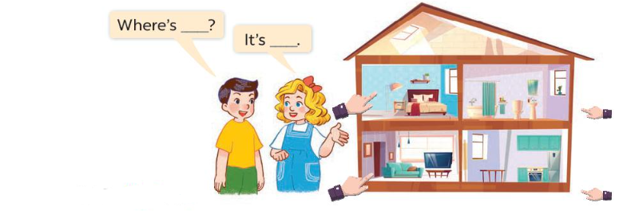
ACTIVITY 3: LET’S TALK
Bedroom
Where’s the bedroom
Bathroom
It’s here
Kitchen
Living room

Slide 18
Play
What’s behind the square?

Slide 19
1
2
3
4
5
6
7
8
Next
tekhnologic

Slide 20
Where
………is the living room? – It’s here.
BACK
How
What

Slide 21
living room
Where is the………..?
BACK
kitchen
bathroom

Slide 22
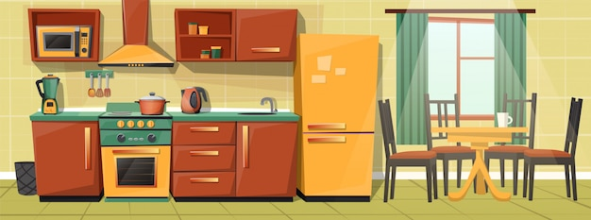
Where is the kitchen?
BACK
It’s there.
It’s here.

Slide 23
Where is the living room?
BACK
It’s there.
It’s here.

Slide 24
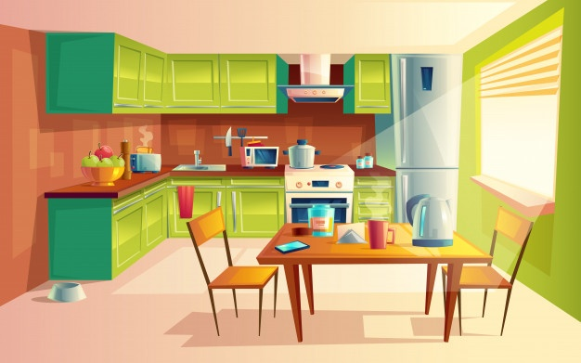
living room
Where is the………..?
BACK
kitchen
bathroom

Slide 25
living room
Where is the………..?
BACK
bathroom
bedroom

Slide 26
Where is the kitchen?
BACK
It’s there.
It’s here.

Slide 27
Where is the house?
BACK
It’s there.
It’s here.

