Slide 1
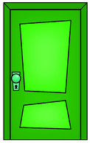
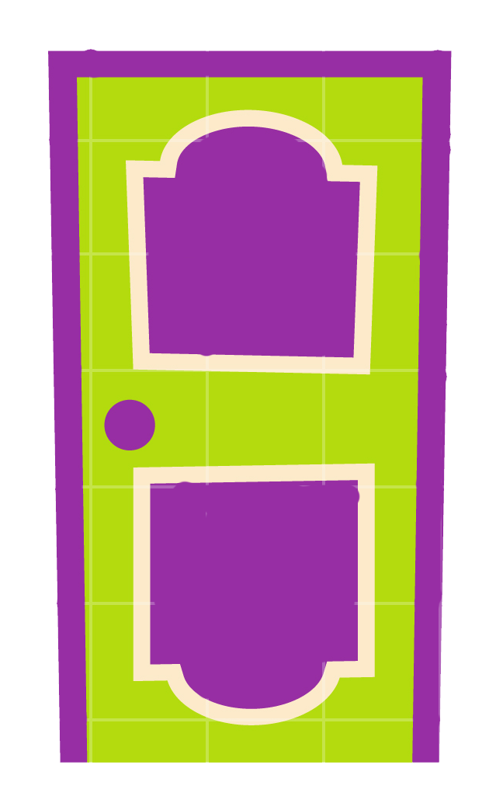
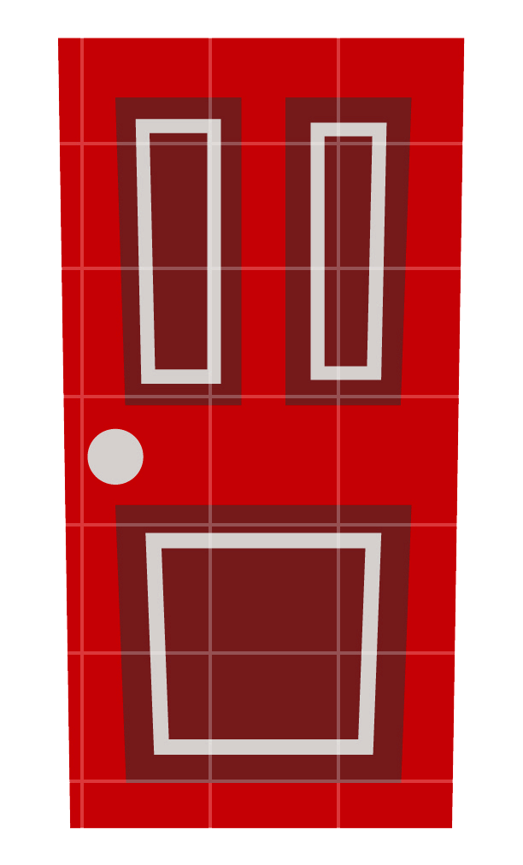
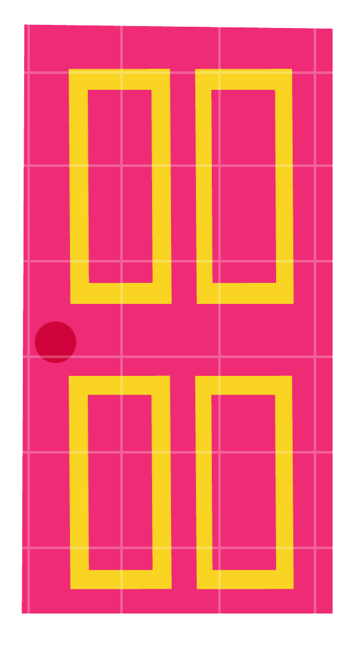
OPEN THE DOORS
1
3
5
4
2
6

Slide 2
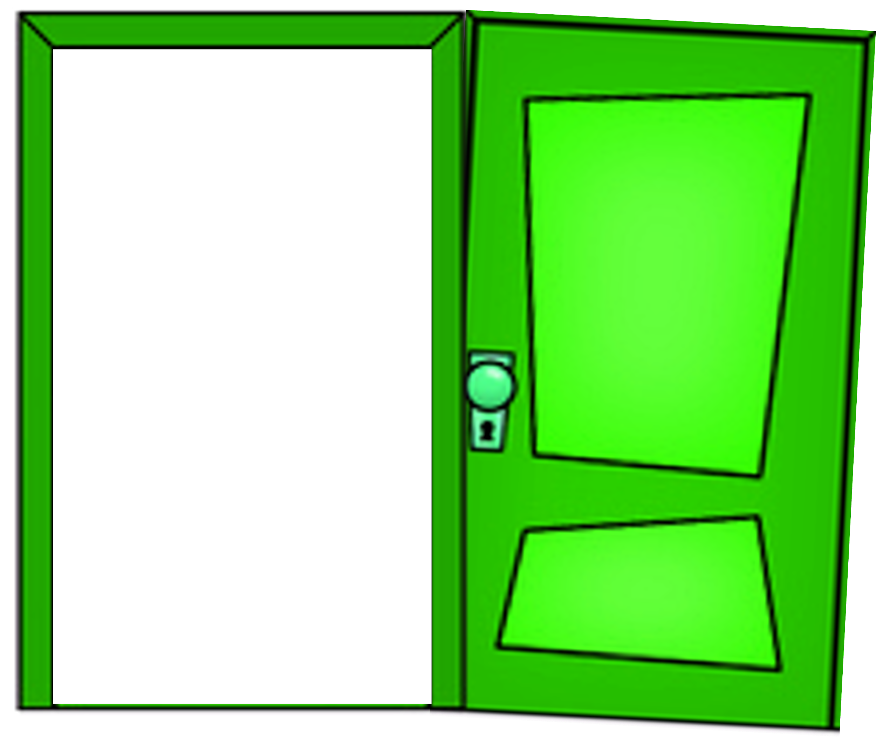
There’s ____ in the room.
Answer
a lamp

Slide 3
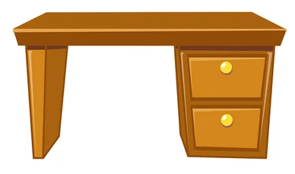
There’s ____ in the room
Answer
a desk

Slide 4
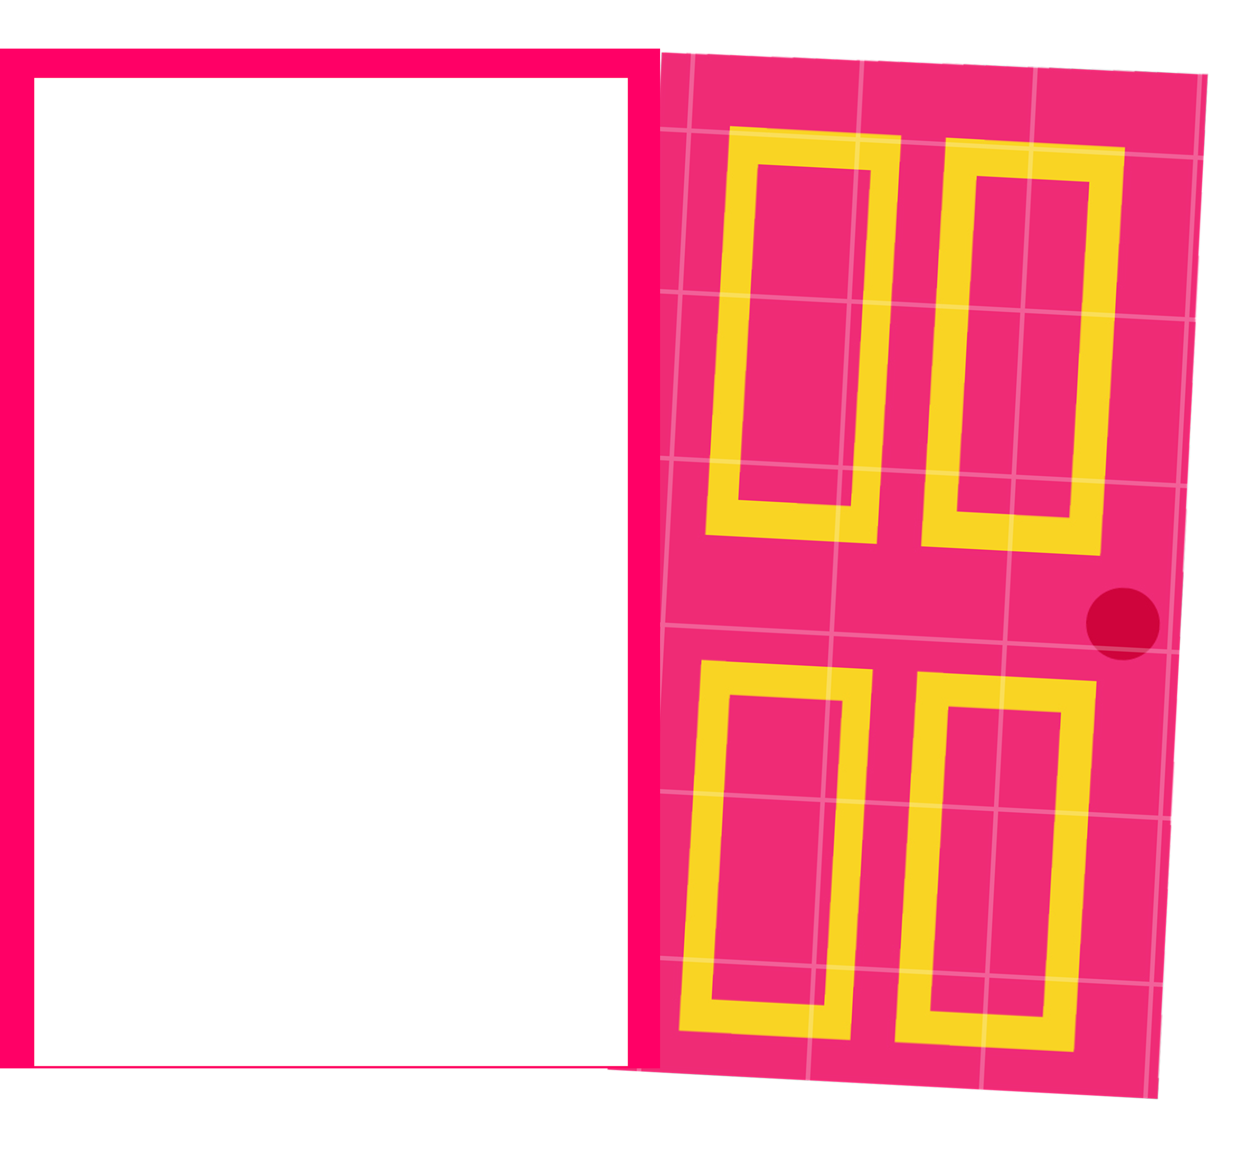
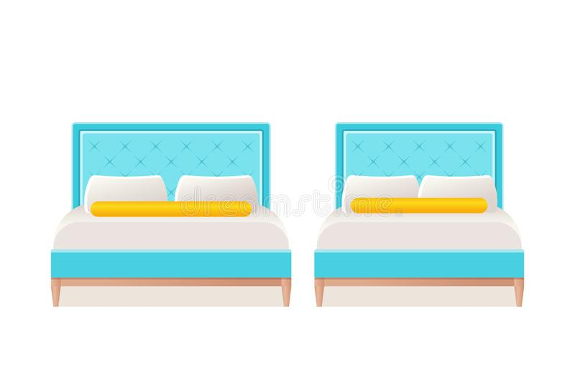
There are ______ in the room.
Answer
two beds

Slide 5
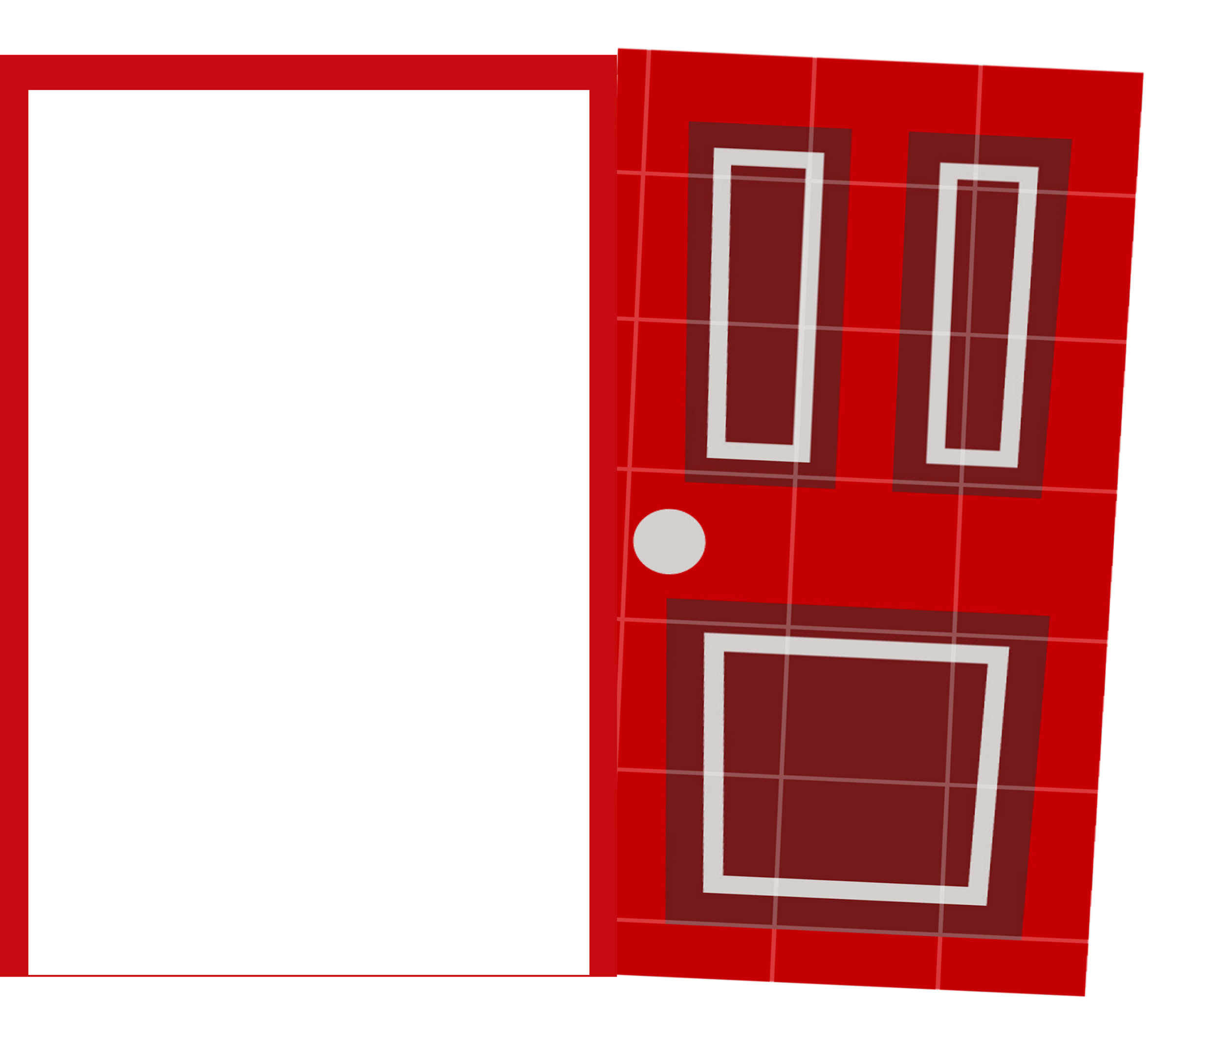
_____ two doors in the room.
A. There is B. There are
Answer
B. There are

Slide 6
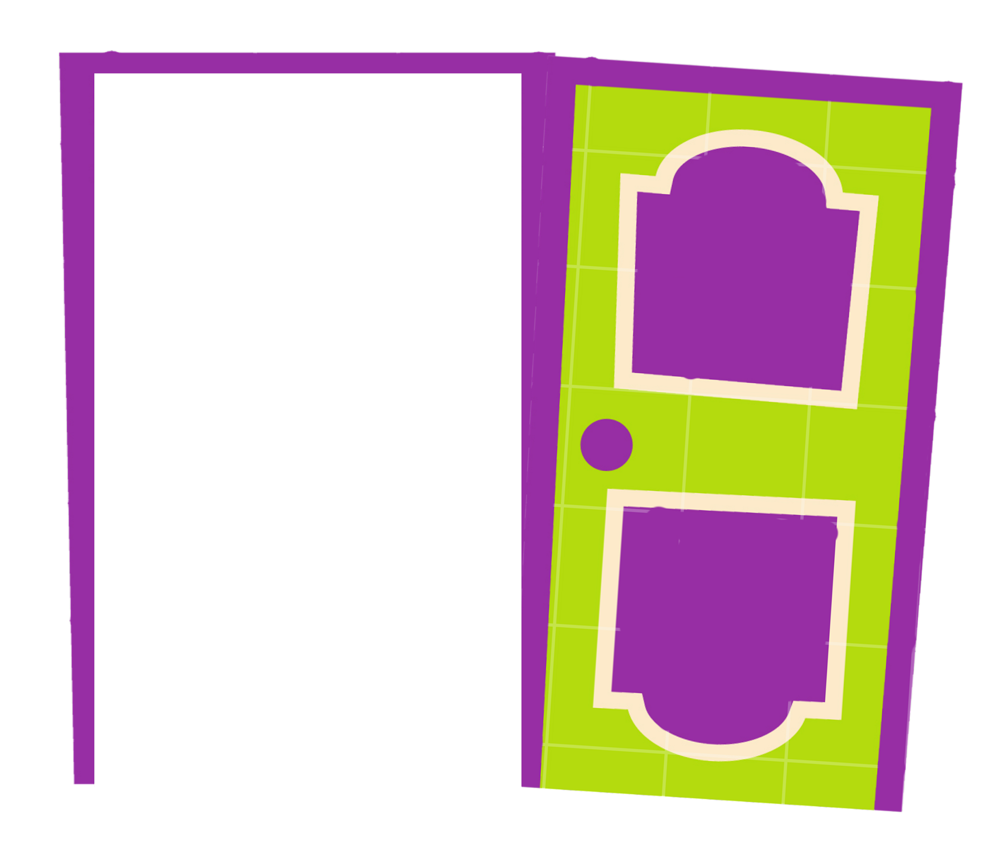
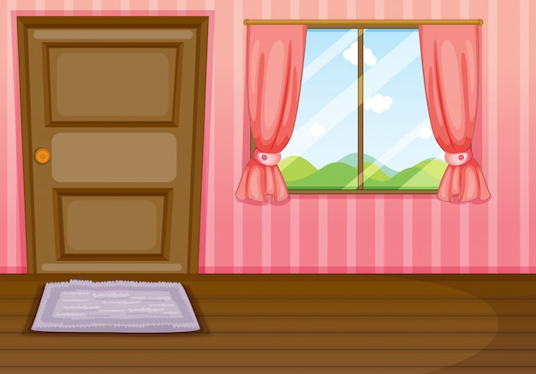
_____ a window in the room.
A. There is B. There are
Answer
A. There is

Slide 7
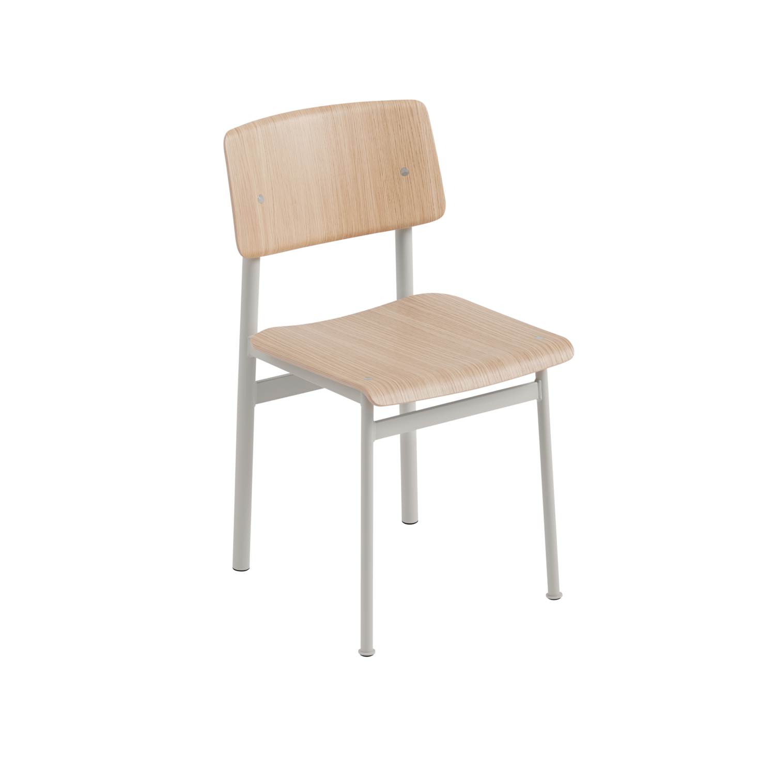
There is _____ in the room.
Answer
a chair

Slide 8
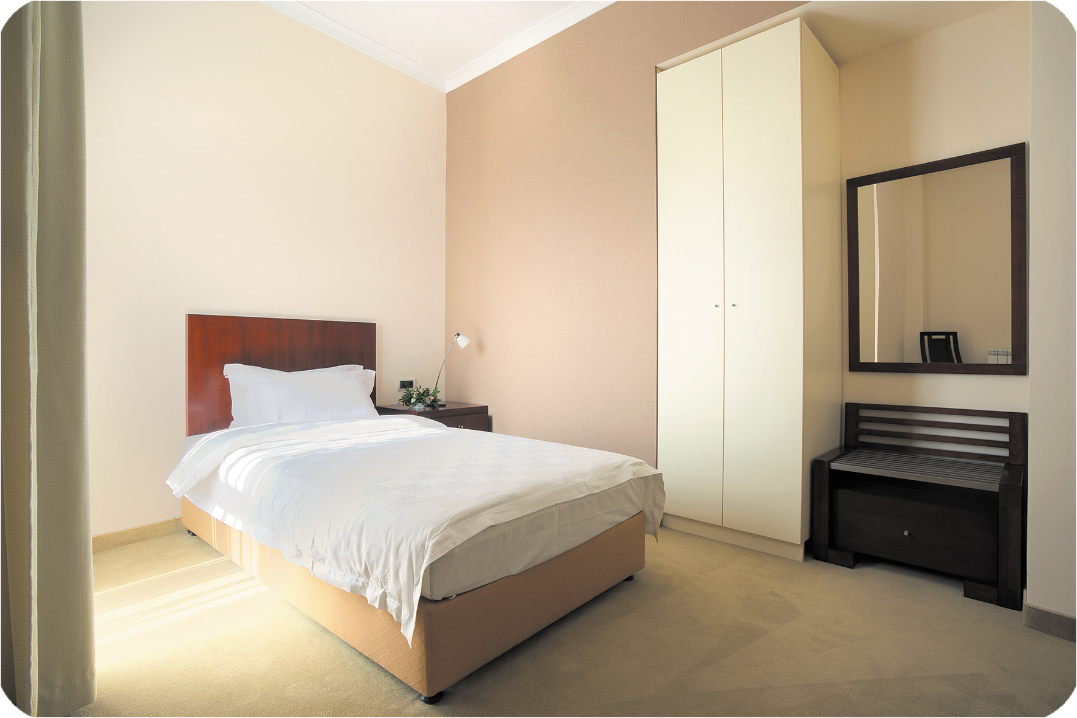
There is __________ in the bedroom.

Slide 9
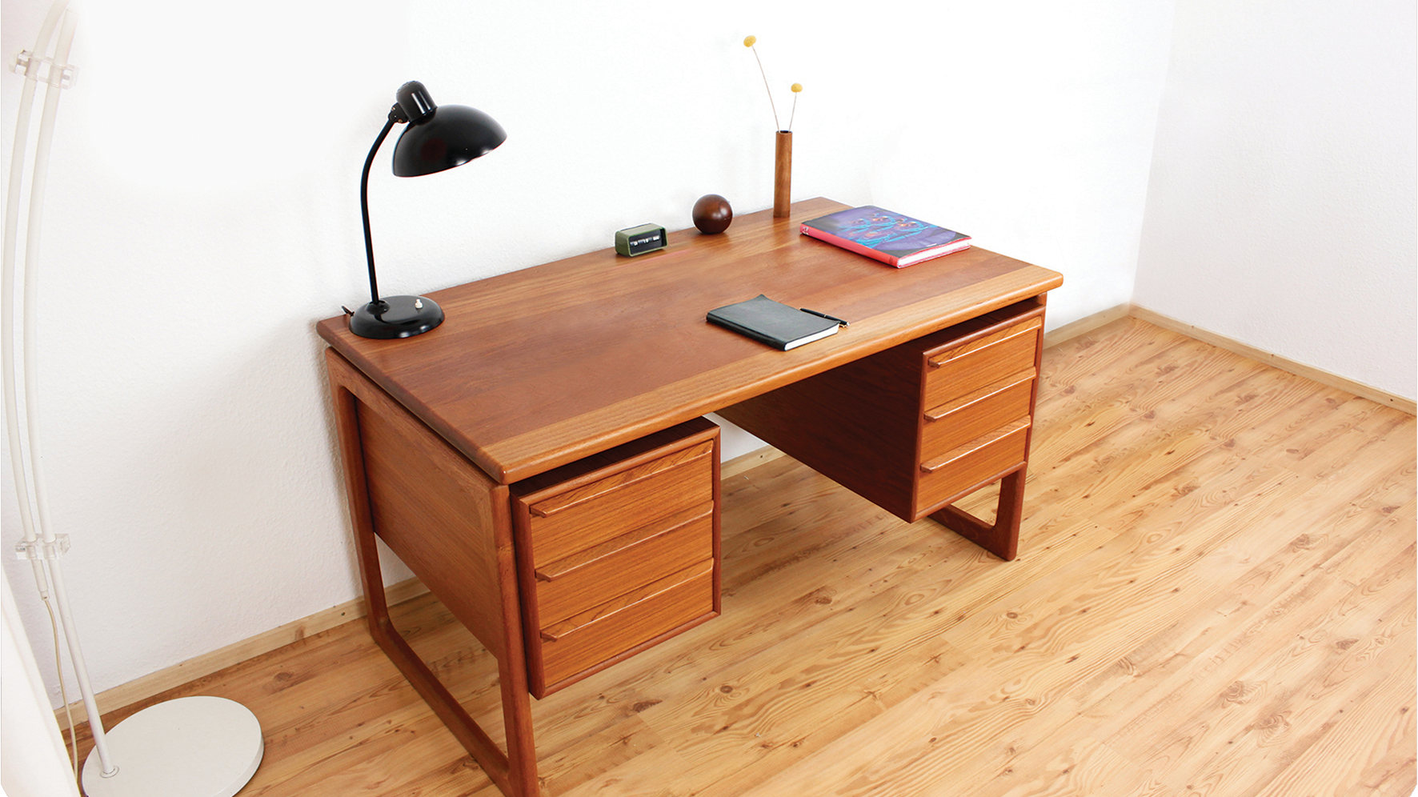
There are __________ in the living room.

Slide 10
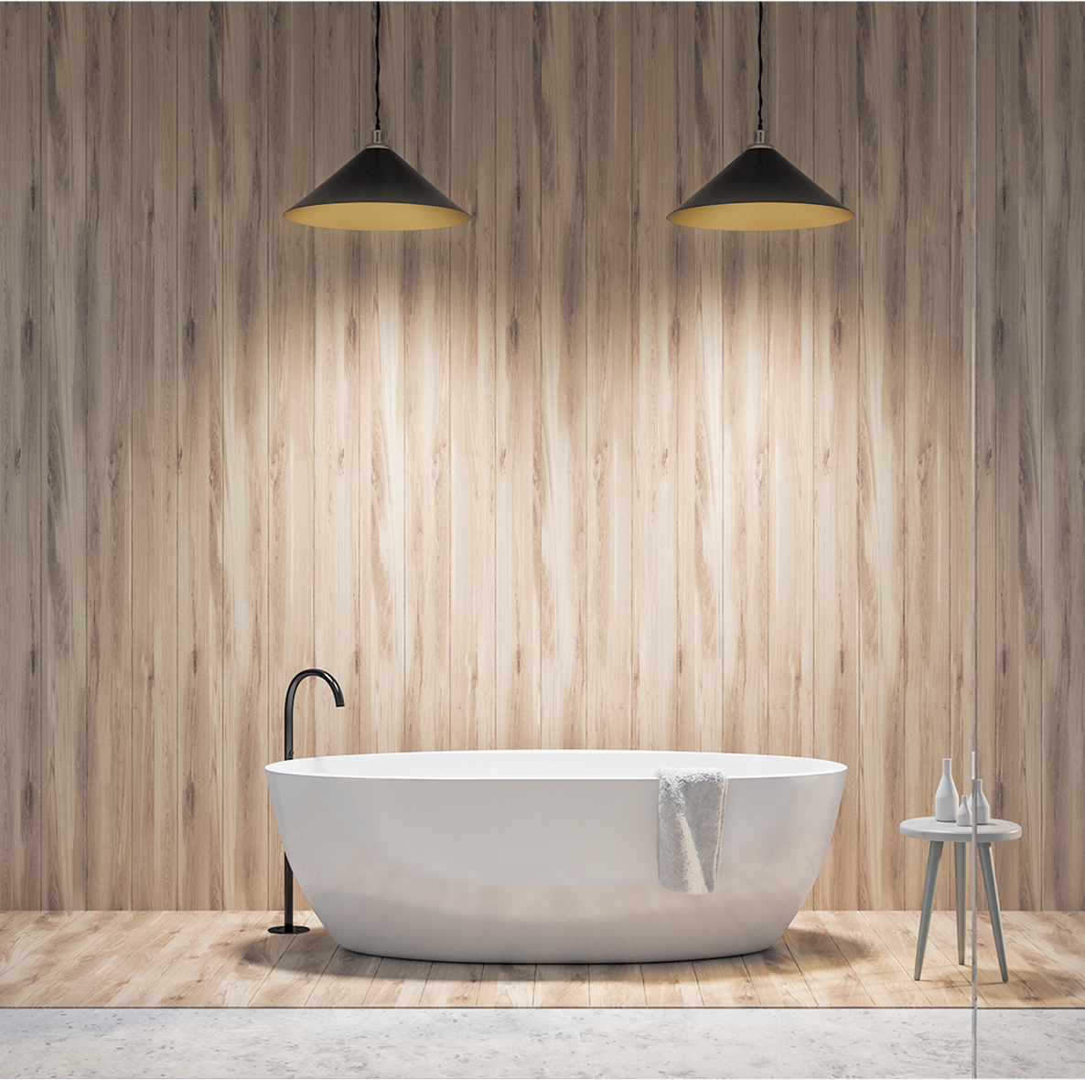
There is __________ in the bathroom.

Slide 11
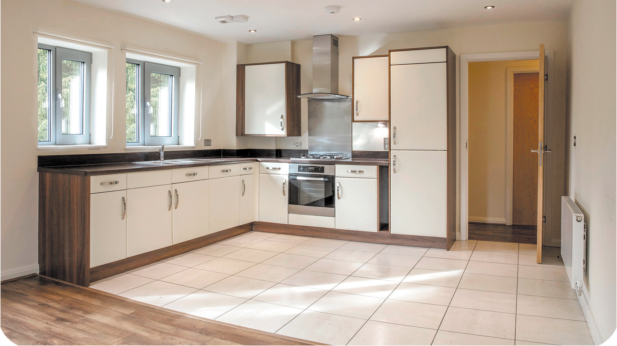
There is ______ in the kitchen.

Slide 12
FUN CORNER

Slide 13
FUN CORNER
https://www.youtube.com/watch?v=lx1e5xakqKM

